Slide 1
WBL Accelerator Training Programme
Europass:
CV and CL

Slide 2
Europass: CV & CL
Find out more about the most successful CV template in Europe.

Slide 3
Europass CV Highlights
Established template since 2005
More than 130 million CVs have been generated since then
Ensures easy understanding of skills, competences and qualifications across EU borders

Slide 4
Europass CV Benefits
Benefit for employees/job applicants:
Online Generator for CV and Cover Letter → easy to save, print and adapt
Benefit for companies:
Standarised structure and jargon/language
Interoperability feature for comparison

Slide 5
Let‘s have a look inside!

Slide 6
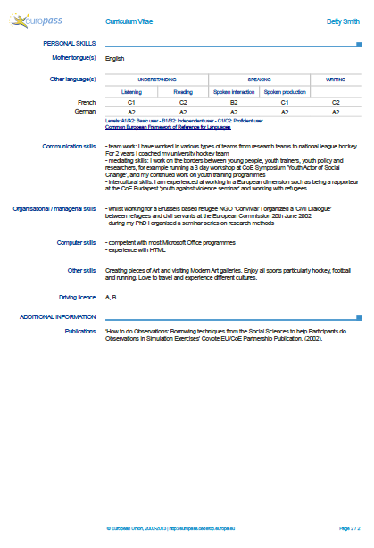
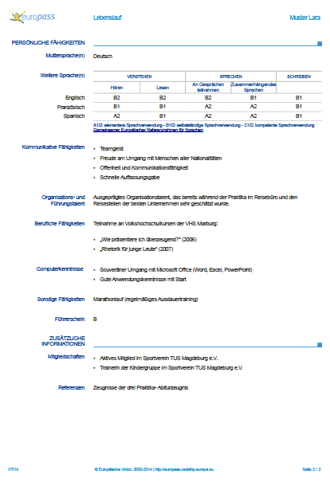
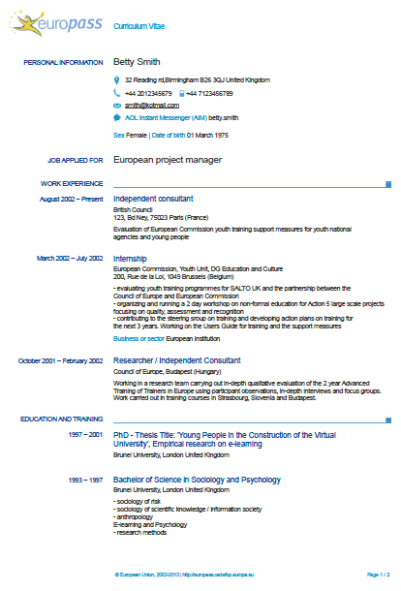
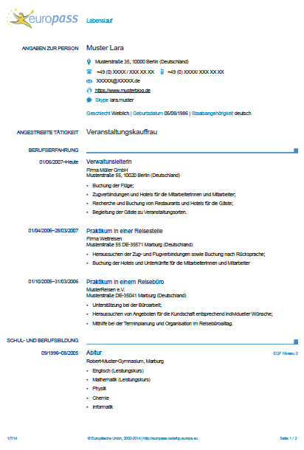

Slide 7
For example:
You immediately know where to look when you search for the most recent education and can compare easily

Slide 8
Or:
Let‘s compare the language skills!
It‘s simple because they are using the same code and the link to the reference framework is also provided if needed.
But once you are familiar with this, you will understand the code easily!

Slide 9
Europass Cover Letter
Features the same format
Provides creators with a basic structure and helpful tips
Shows all necessary contact info in the header

