Slide 1
Introduction to WBL
What is Work-Based Learning?

Slide 2
What is Work-based learning?
According to the European Training Foundation:
Work-based learning refers to learning that occurs when people do real work. This work can be paid or unpaid, but it must be real work that leads to the production of real goods and services (ETF, 2018, p. 5).
Practical learning that takes place in an educational institution – for instance in a vocational college’s workshop – and classroom-based learning that happens to take place in an enterprise are not WBL. Virtual firms, practice firms and simulation tools are used by some educational institutions. These are not a substitute for the participation of learners in work practice and process, as they cannot create all of the features of a real workplace, but they can be useful when the alternative is difficult to access (ETF, 2014, pp. 3–4).

Slide 3
Benefits for stakeholders
Companies tend to be:
More productive
More profitable
More innovative
More effective using employees’ knowledge to improve the quality of the products and customers service
Companies involved in WBL also have a lower staff turnover.
(European Training Foundation, 2018. A handbook for policy makers and social partners in ETF partner countries, p. 6)

Slide 4
Benefits for stakeholders
2. Learners
WBL makes their studies more interesting and connects them to the real world of work
WBL improve their employability (WBL offers and opportunity to acquire “real world” skills and create contacts with potential employers)
Supports their social inclusion
(European Training Foundation, 2018. A handbook for policy makers and social partners in ETF partner countries, p. 6)

Slide 5
Benefits for stakeholders
3. Employees
WBL encourages employees to improve their career prospects and increases chances that they will be interested in taking part on further formal VET training
(European Training Foundation, 2018. A handbook for policy makers and social partners in ETF partner countries, p. 6)

Slide 6
Benefits for stakeholders
4. Policy makers, post-secondary and VET
WBL strengthen cooperation between educational institutions and businesses
It creates strong links for the whole system (involving all the stakeholders)
WBL creates an opportunity for the employers to design and manage VET
Work-based learning support developing higher-quality skills that are more relevant to the real world of work than learning which occurs in the classrooms only
WBL support development of skills that tend to be more up to date and more relevant to the workplace
WBL support an effective usage of the employers premises and equipment for training purposes (eliminating the need to purchase expensive training equipment)
WBL creates learning opportunities that many of the publicly finance VET schools and colleges can not afford.
(European Training Foundation, 2018. A handbook for policy makers and social partners in ETF partner countries, p. 6)

Slide 7
Benefits for stakeholders
5. Entities running schools and colleges
WBL offers a way how to develop their students skills such as team-work, problem solving and basic habits such as punctuality
WBL shows the relevance of their study in connection with their studies and future jobs and this way raising their interest in studying
WBL support social inclusion of their students including disadvantage students.
(European Training Foundation, 2018. A handbook for policy makers and social partners in ETF partner countries, p. 6)

Slide 8
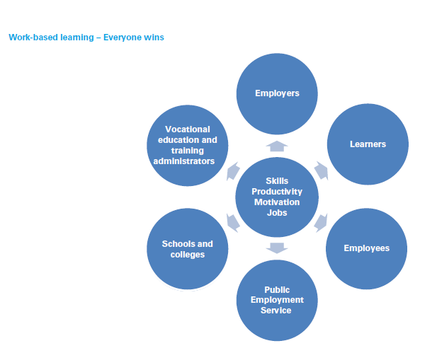
WBL – Everyone wins!
Source: (European Training Foundation, 2018. A handbook for policy makers and social partners in ETF partner countries, p. 10)

Slide 9
DIFFERENT TYPES OF WORK-BASED LEARNING
There are different approaches to WBL in VET. The Inter-Agency Work Group on WBL (Cedefop, ETF, European Commission, ILO, OECD, UNESCO) has identified three main types of WBL.
Apprenticeships provide occupational skills and typically lead to a recognised qualification. They combine learning in the workplace with school-based learning in a structured way. In most cases, apprenticeships last several years. Most often the apprentice is considered an employee, and has a work contract and a salary.

Slide 10
DIFFERENT TYPES OF WORK-BASED LEARNING
Traineeships and internships are workplace training periods that complement formal or nonformal education and training programmes. They may last from a few days or weeks to months. They may or may not include a work contract and payment. (The EU has established a Quality Framework for Traineeships that recommends written agreements.)
On-the-job training is training which takes place in the normal work environment. It is the most common type of WBL throughout an individual’s working life.
Source: Thomas, S. (2017), WORK-BASED LEARNING IN EU CANDIDATE COUNTRIES, Available at: https://www.etf.europa.eu/sites/default/files/m/333F8DD829CBDBDFC12581FE00299A16_Work-based%20learning_candidate%20countries.pdf (Accessed 1st August 2019)

